Slide 1
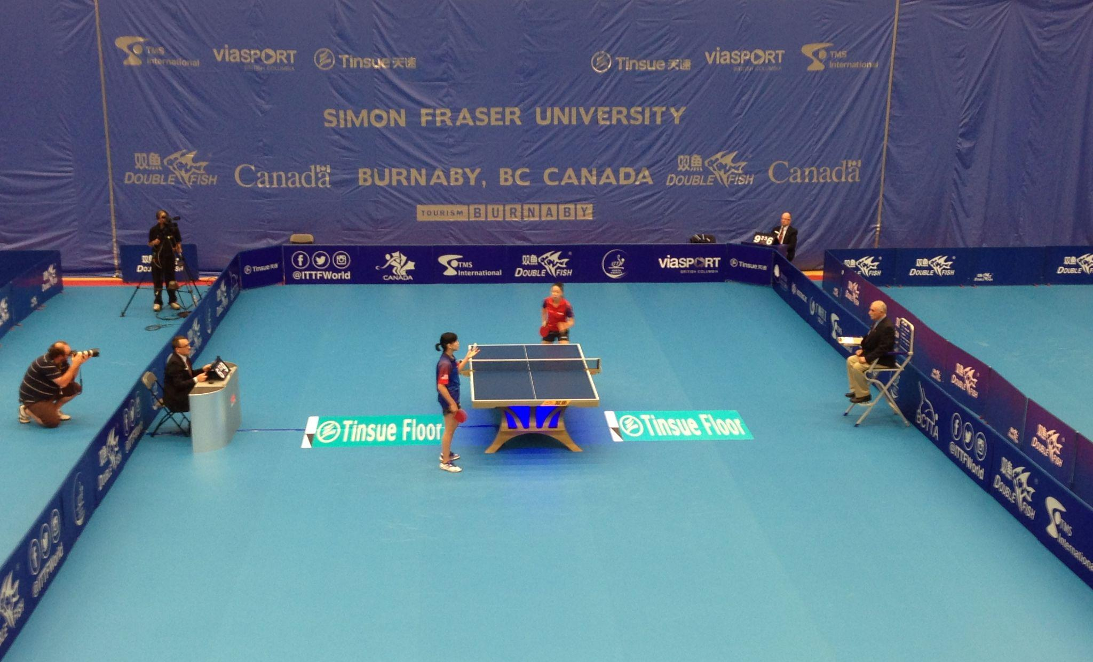
My hobby
Acting as referee in table tennis

Slide 2
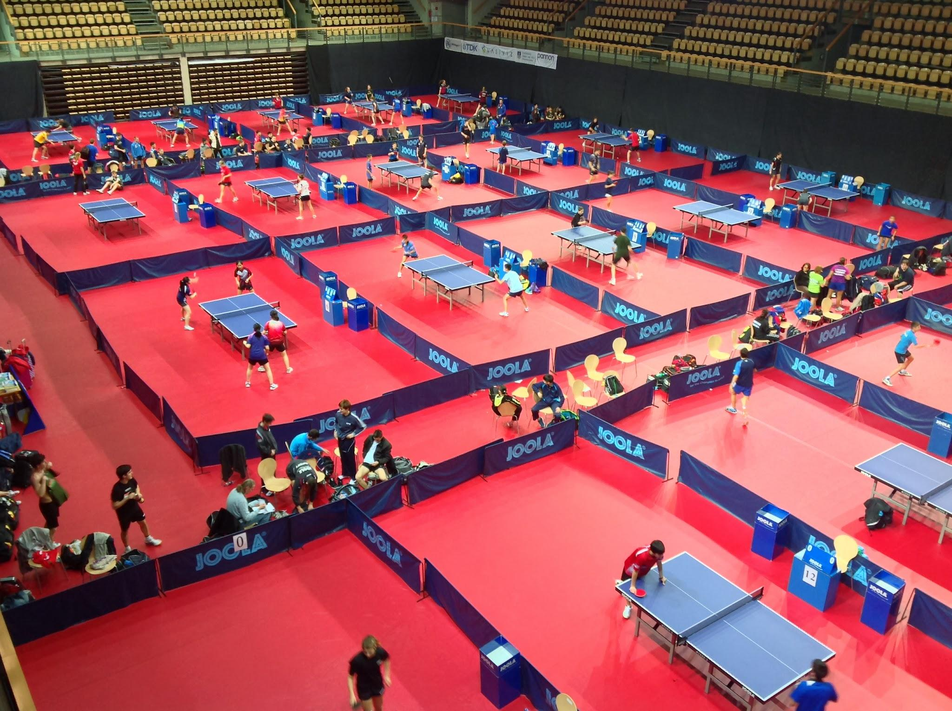
What does a referee do?
The referee is one of the main chief at table tennis competitions. His duty is to do the schedule and draws (who plays against who). During the event he has to supervise the whole event. If something happens he is called to handle it.

Slide 3
Why to become table tennis referee?
PROS
CONS
Travel around the world
Get new friends
Be close to sport
High salary (joking)
Long working days
Long competitions, many days far from the family

Slide 4
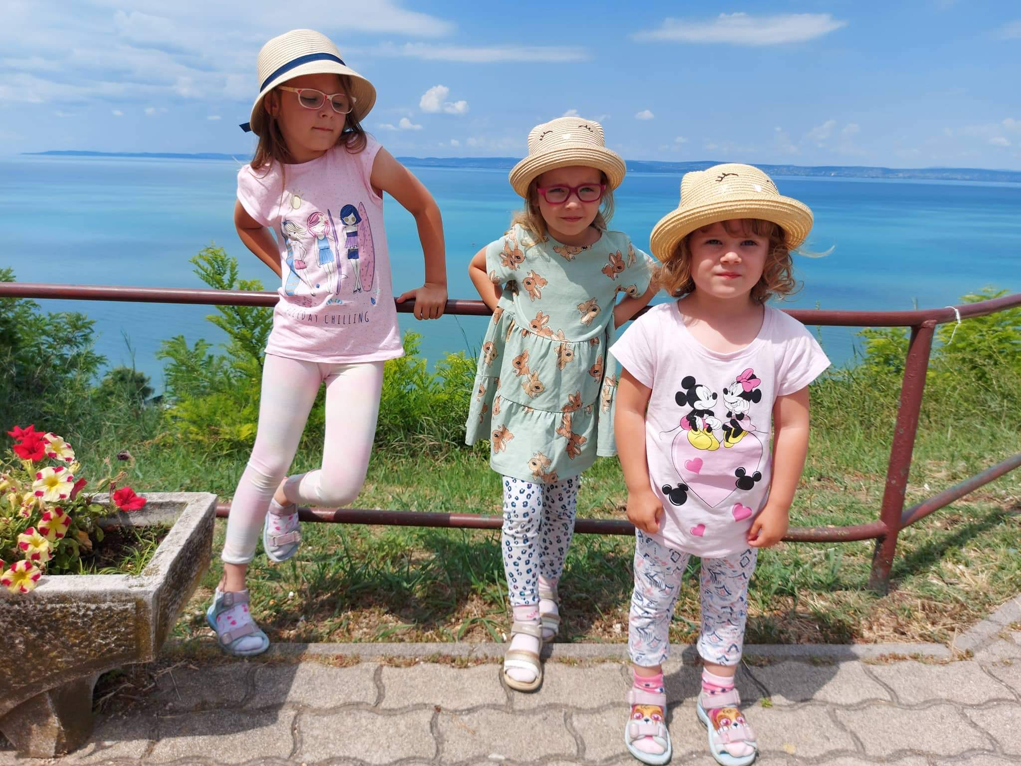
THANK YOU FOR YOUR ATTENTION

